Slide 1

SSN College of Engineering
Department of Information Technology
UIT2502 – DATA ANALYTICS AND VISUALIZATION
MULTIMODAL SLEEP STAGE CLASSIFICATION
Dr K.S. Gayathri
Associate Professor
Department of Information Technology
Team Members
Harikaran C 3122235002040
Priyan RR 3122235002092

Slide 2

PROBLEM STATEMENT
Manual sleep scoring by specialists is extremely time-consuming, costly, and prone to human subjectivity, creating a significant bottleneck in diagnosing sleep disorders.
Sleep stages are defined by a complex interplay of physiological signals. Relying on a single signal (like EEG alone) is insufficient and leads to critical errors. Distinguishing complex stages like REM sleep is impossible without simultaneously analyzing brain activity (EEG), eye movements (EOG), and muscle tone (EMG).
There is a critical need for an automated system that can intelligently fuse and interpret these multimodal signals, providing an accurate, objective, and rapid classification of sleep stages to accelerate both clinical diagnosis and research

Slide 3
OBJECTIVE
Data Ingestion: To ingest and synchronize multimodal PSG recordings (EEG, EOG, EMG, Respiration, Temperature).
Analysis: To perform rigorous Exploratory Data Analysis (EDA) to understand sleep architecture and signal distributions.
Classification: To develop a hybrid CNN-LSTM model that extracts spatial features and learns temporal dependencies for 5-class sleep staging.
Validation: To statistically validate feature significance (ANOVA) and evaluate model performance using confusion matrices and accuracy curves.

Slide 4
DATASET DESCRIPTION
Source: PhysioNet Sleep-EDF Database (Expanded)
Data Structure: Full overnight Polysomnography (PSG) recordings matched with expert-annotated Hypnograms.
Key Channels Used :
  EEG (Fpz–Cz): Primary brainwave analysis.
  EOG (Horizontal): Detecting Rapid Eye Movements.
  EMG (Submental): Measuring muscle atonia.
  Contextual: Respiration (Airflow) & Temperature (Rectal).
Granularity: Data segmented into 30-second epochs.
Total Epochs: 27000
Train: 21600 (80%)
Validation: 5400 (20%)
Models Used: Hybrid CNN-LSTM

Slide 5
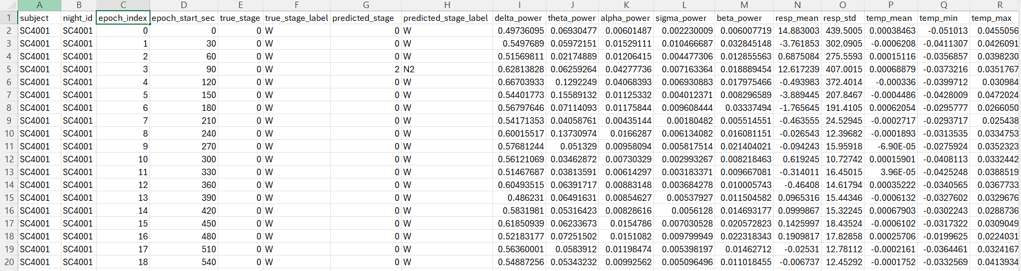
SAMPLE DATASET

Slide 6

PROPOSED METHODOLOGY
Data Acquisition: Ingested raw multimodal PSG signals (EEG, EOG, EMG, Respiratory, Temp) from the dataset to capture comprehensive sleep dynamics.
Signal Preprocessing: Applied band-pass filtering (0.3–35 Hz) and resampling (100 Hz) to remove noise, followed by Z-score normalization for model stability.
Segmentation: Sliced continuous time-series data into standard 30-second non-overlapping epochs, aligning with AASM clinical scoring guidelines.
Feature Strategy: Utilized 1D-CNN layers for automated spatial feature learning and extracted Spectral Power Density for statistical validation.
Hybrid Modeling: Trained a CNN-LSTM network to simultaneously extract local waveform patterns and learn long-term temporal sequence dependencies.
Analytics & Visualization: Validated feature significance via statistical testing and deployed an interactive Power BI Dashboard for interpretable sleep architecture analysis.

Slide 7
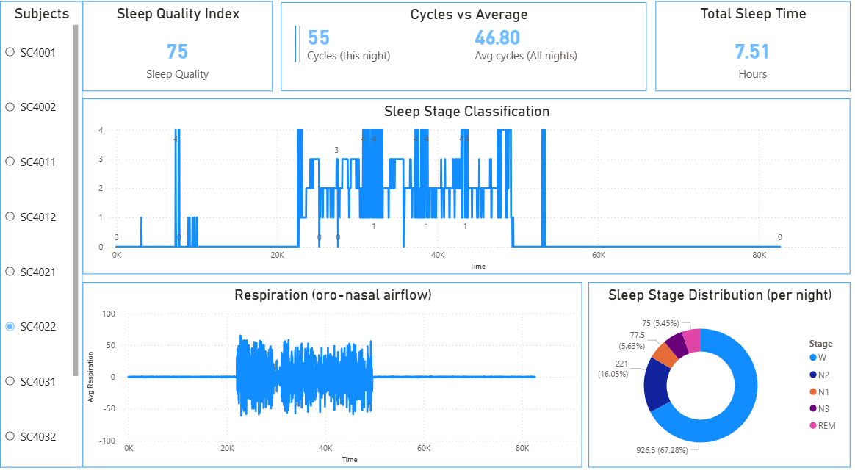
EXPLORATORY DATA ANALYSIS – EDA
Sleep Architecture and Class Imbalance
Key Insights:
Dominant Stages: Wake (W) and N2 are the most frequent stages, representing the bulk of the dataset.
Underrepresented Stages: N1 (transitional) and N3 (deep sleep) have fewer epochs.
This imbalance necessitates the use of class-weighted learning in the model to prevent bias toward the majority classes.

Slide 8
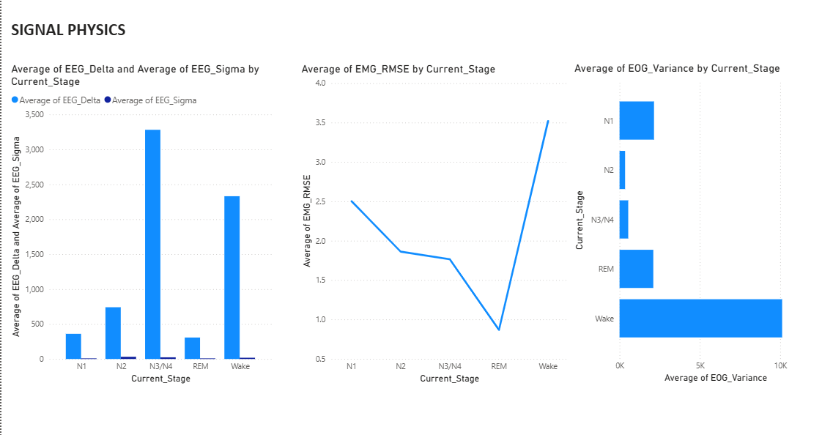
EXPLORATORY DATA ANALYSIS – EDA
Key Insights:
Goal: Prove that signals have unique features.
EEG: The N3/N4 bar will be massive. This proves CNNs can find Deep Sleep using Delta waves.
EMG:The line will drop to the bottom for REM. This proves CNNs can find REM using muscle paralysis.
EOG: Wake and REM will have long bars (eye movement), while N1/N2/N3 will be short.

Slide 9
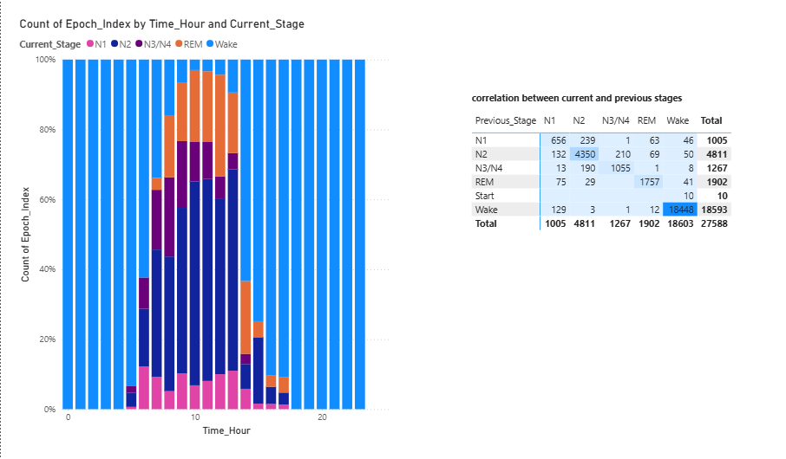
EXPLORATORY DATA ANALYSIS – EDA
Hypnogram Analysis and Transition Matrix
Key Insights:
Hypnogram Analysis: It
revealed that Deep Sleep (N3) is dominant in the first half of the night (Hours 0–4), while REM cycles become longer and more frequent in the second half.
Transition Matrix: The Heatmap showed a strong "diagonal," meaning stages tend to persist. It also showed specific transition probabilities

Slide 10
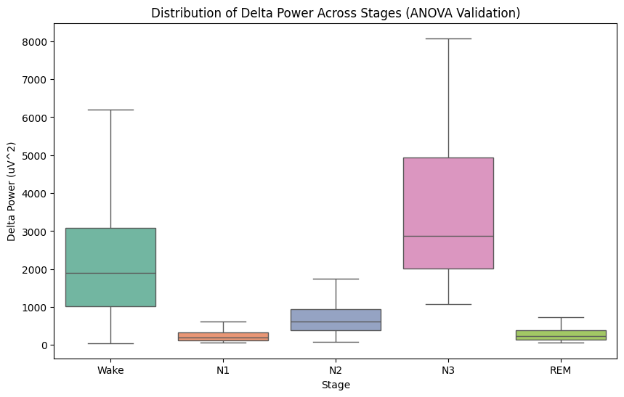
EXPLORATORY DATA ANALYSIS – EDA
BOXPLOT
Key Insights:
Deep Sleep Signature: Delta power peaks significantly in Stage N3, confirming it as the restorative slow-wave sleep.
Wake vs. Sleep: Wakefulness shows high variability (outliers) due to movement artifacts.
Separability: Non-overlapping medians between N1, N2, and N3 indicate that EEG power is a valid discriminator for classification.

Slide 11
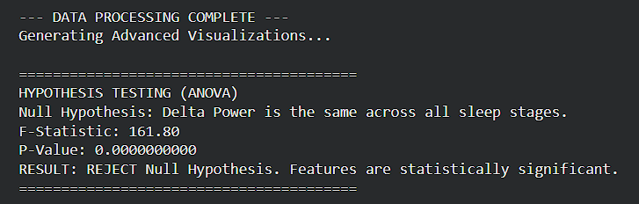
HYPOTHESIS TESTING
Statistical Test 1: ANNOVA
TEST OUTPUT:
Objective:
  To scientifically prove that physiological features differ across sleep stages.
  Why This Test?
  It mathematically proves that your features work. It checks if "Delta Power" (Deep sleep signal) is actually different in N3 compared to Wake.
Hypotheses:
  Null Hypothesis: Mean feature values (e.g., Delta Power) are identical across all sleep stages.
  H₁: A significant difference exists
Reject Null Hypothesis
There is overwhelming statistical evidence that sleep stages have distinct physiological signatures, validating our feature selection.

Slide 12
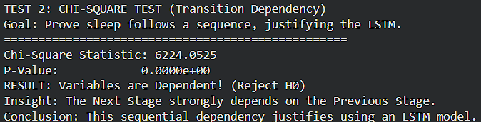
HYPOTHESIS TESTING
Statistical Test 1: CHI SQUARE TEST
TEST OUTPUT:
Objective:
  To determine if sleep stages follow a structured sequence or occur randomly. This validates the need for a sequence model (LSTM).
Hypotheses:
  Null Hypothesis H0: The Next Sleep Stage is independent of the Previous Sleep Stage (Random transitions).
  Alternate Hypothesis H1: The Next Sleep Stage is dependent on the Previous Sleep Stage (Structured transitions).
Reject Null Hypothesis
Sleep is not random; it follows a specific "grammar". This strong sequential dependency provides the mathematical justification for using an LSTM network over a standard Neural Network.

Slide 13
The CNN-LSTM Model Architecture
LSTM
CNN
The Convolutional Neural Network acts as an automated feature extractor.
It scans the raw signals within each epoch to identify key waveforms and spatial patterns, such as sleep spindles and K-complexes.
Long Short-Term Memory network receives the features from the CNN.
It analyzes the sequence and temporal relationship of these patterns, understanding that sleep is a dynamic process confirmation of defect severity

Slide 14
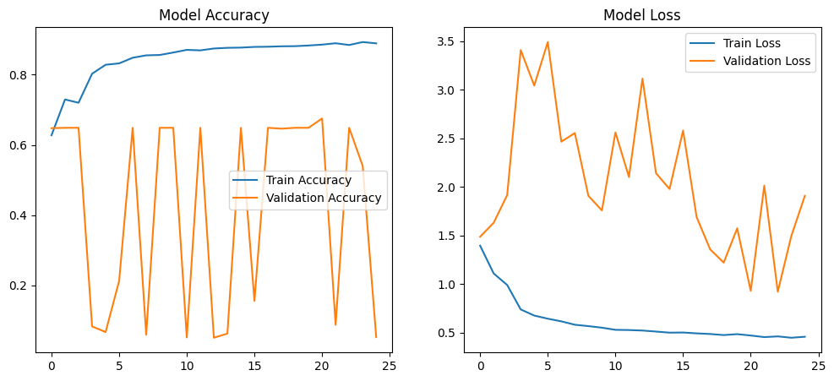
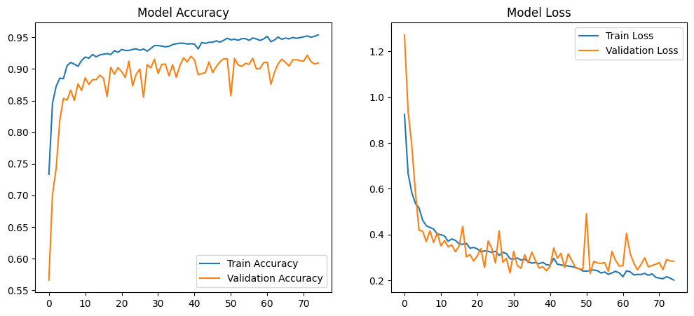
Training History
No. of Epochs : 25
  Analysis:
  The plots show that both training and validation accuracy steadily increased over 75 epochs, while the loss decreased.
  Insight:
  The validation accuracy closely tracks the training accuracy.
  This indicates that the model is generalizing well to new, unseen data and is not overfitting (i.e., it's not just memorizing the training data).
No. of Epochs : 75

Slide 15
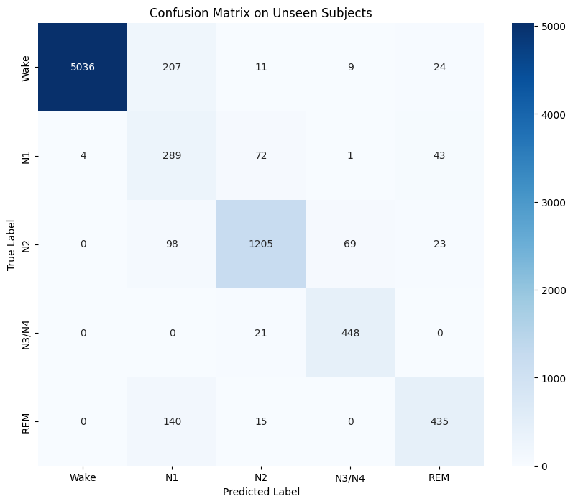
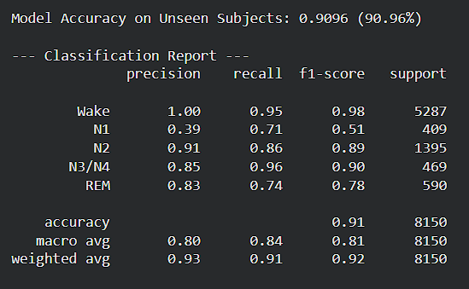
Performance on Unseen Subjects
  Overall Accuracy:
  The model achieved an overall accuracy of 90.96% on the test set.
  Confusion Matrix Analysis:
  The model shows high performance in identifying distinct stages like Wake, N2, and N3/N4.
  As expected, there is some confusion between physiologically similar stages, primarily N1 and Wake, and N1 and REM, which is a known challenge in the field.

Slide 16
THANK YOU

